Slide 1

SCIANTIX: Advanced developments
Hands on the source code
Developer side: Editing and (re)compiling
Advanced modelling: Machine Learning with SCIANTIX
Survey
Giovanni Zullo
Lyon, France, 15.05.2024

Slide 2
SCIANTIX: Advanced developments
Hands on the source code
Developer side: Editing and (re)compiling
Advanced modelling: Machine Learning with SCIANTIX
Survey
Giovanni Zullo
Lyon, France, 15.05.2024

Slide 3
Hands on the source code
MainSCIANTIX.C
Input reading & initialization
Temporal loop
Sciantix.C/h
Closing execution

Slide 4
Hands on the source code
MainSCIANTIX.C
Sciantix.C/h
Solvers
Simulation
Models
Input reading & initialization
_options
_history
_variables
_scaling_factors
_diffusion_modes
Temporal loop
objects
Closing execution

Slide 5
Hands on the source code
Sciantix.C/h
Set
Simulation
Update

Slide 6
Hands on the source code
Sciantix.C/h
Set
SetVariables(…);
SetGas();
SetMatrix();
SetSystem();
Simulation
Update

Slide 7
Hands on the source code
Sciantix.C/h
Simulation sciantix_simulation;
Burnup();
MapModel();
sciantix_simulation.Burnup();
…
InterGranularBubbleEvolution();
MapModel();
sciantix_simulation.InterGranularBubbleBehaviour();
Set
Simulation
Update

Slide 8
Hands on the source code
Sciantix.C/h
Set
FiguresOfMerit();
UpdateVariables(…);
Output();
Simulation
Update
output.txt

Slide 9
Hands on the source code
Set
SetVariables.C/h
input_variable.emplace_back();
input_variable[iv_counter].setName("iFGDiffusionCoefficient");
input_variable[iv_counter].setValue(Sciantix_options[1]);
++iv_counter;
…
history_variable.emplace_back();
history_variable[hv_counter].setName("Temperature");
history_variable[hv_counter].setUOM("(K)");
history_variable[hv_counter].setInitialValue(Sciantix_history[0] * Sciantix_scaling_factors[4]);
history_variable[hv_counter].setFinalValue(Sciantix_history[1] * Sciantix_scaling_factors[4]);
history_variable[hv_counter].setOutput(1);
++hv_counter;
…
sciantix_variable.emplace_back();
sciantix_variable[sv_counter].setName("Xe produced");
sciantix_variable[sv_counter].setUOM("(at/m3)");
sciantix_variable[sv_counter].setInitialValue(Sciantix_variables[1]);
sciantix_variable[sv_counter].setFinalValue(Sciantix_variables[1]);
sciantix_variable[sv_counter].setOutput(1);
++sv_counter;
SetGas.C/h
void SetGas()
{
Xenon();
MapGas();
Krypton();
MapGas();
Helium();
MapGas();
}
SetMatrix.C/h
void SetMatrix( )
{
switch (int(input_variable[iv["iFuelMatrix"]].getValue()))
{
case 0:
{
UO2();
MapMatrix();
break;
}
…
SetSystem.C/h
void SetSystem()
{
switch (int(input_variable[iv["iFuelMatrix"]].getValue()))
{
case 0:
{
Xe_in_UO2();
MapSystem();
Kr_in_UO2();
MapSystem();
He_in_UO2();
MapSystem();
…

Slide 10
Hands on the source code
Burnup.C/h
void Burnup()
{
model.emplace_back();
int modelIndex = model.size() - 1;
model[modelIndex].setName("Burnup");
…
Simulation
Simulation sciantix_simulation;
Burnup();
MapModel();
sciantix_simulation.Burnup();
…
InterGranularBubbleEvolution();
MapModel();
sciantix_simulation.InterGranularBubbleBehaviour();
Simulation.h
…
void Burnup()
{
/**
* Burnup uses the solver Integrator to compute the fuel burnup from the local power density. This method is called in Sciantix.C, after the definition of the Burnup model.
*/
sciantix_variable[sv["Burnup"]].setFinalValue(
solver.Integrator(
sciantix_variable[sv["Burnup"]].getInitialValue(),
model[sm["Burnup"]].getParameter().at(0),
physics_variable[pv["Time step"]].getFinalValue()
)
);
…

Slide 11
Hands on the source code
Update
UpdateVariables.C/h
Sciantix_variables[0] = sciantix_variable[sv["Grain radius"]].getFinalValue();
Sciantix_variables[1] = sciantix_variable[sv["Xe produced"]].getFinalValue();
…

Slide 12
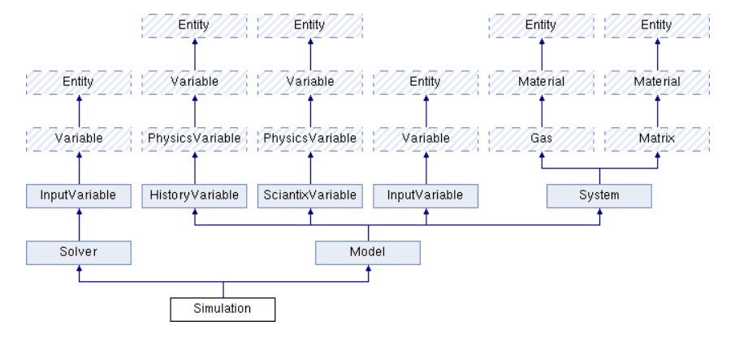
Hands on the source code, objects
Fission gas / Helium
in UO₂ / MOX
Fission gas / Helium behaviour
Production
Diffusion
(Solubility)
Interaction FG - He → bubbles

Slide 13
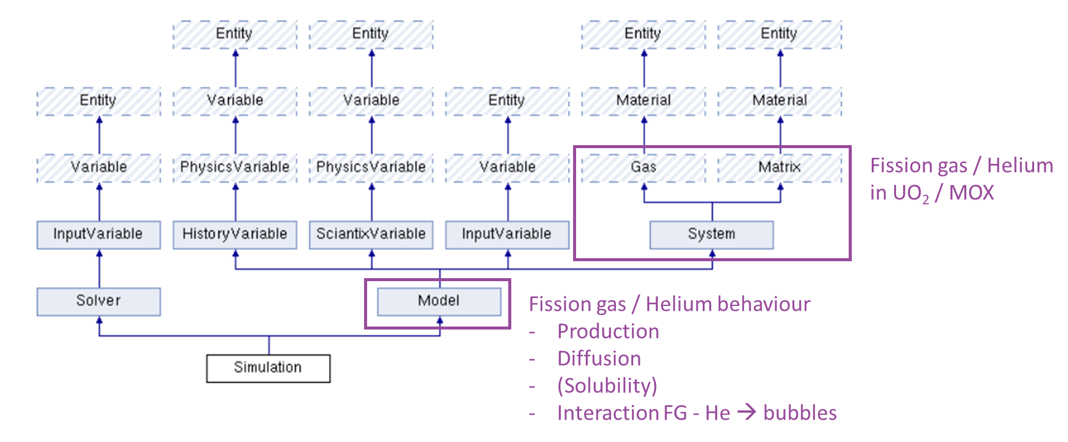
Hands on the source code, objects
/// Derived class for gases (e.g., xenon, krypton, helium).
class Gas : virtual public Material
{
protected:
int atomic_number;
double mass_number;
double van_der_waals_volume;
double decay_rate;
double precursor_factor;
public:
void setAtomicNumber(int y)
{
/// Member function to set the atomic number of the fission gas
atomic_number = y;
}
…

Slide 14
Hands on the source code, objects
/// Derived class for SCIANTIX models.
class Model : public HistoryVariable, public SciantixVariable, public InputVariable, public System
{
protected:
std::string overview;
std::vector<double> parameter;
public:
void setParameter(std::vector<double> p)
{
parameter = p;
}
std::vector<double> getParameter()
{
return parameter;
}
// Constructor & destructor
Model() {}
~Model() {}
};

Slide 15
SCIANTIX: Advanced developments
Hands on the source code
Developer side: Editing and (re)compiling
Advanced modelling: Machine Learning with SCIANTIX
Survey
Giovanni Zullo
Lyon, France, 15.05.2024

Slide 16
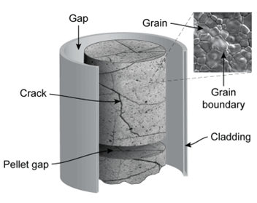
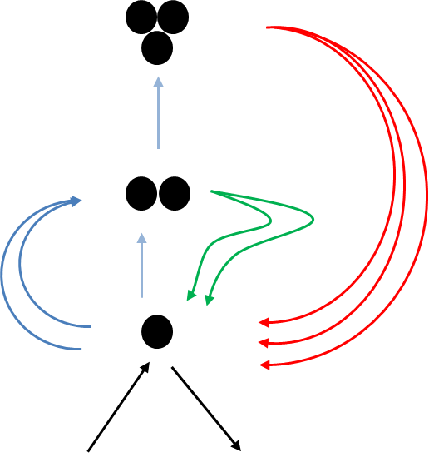
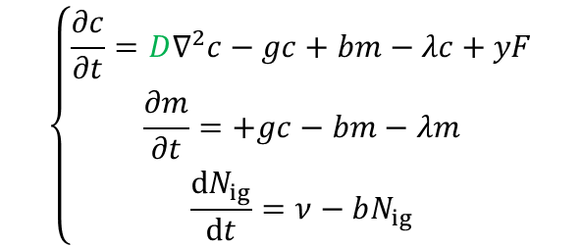
Developer side, Editing and (re)compiling
Intragranular gas diffusion
Fundamental parameters: diffusivity (single atoms), bubble nucleation, trapping, re-solution (w/ He solubility)
Physically-based single-size model derived from cluster dynamics (clusters with size n > 2 are counted as bubbles)
→ intragranular gaseous swelling
$$\left\{\begin{aligned}\frac{∂c}{∂t}=D∇^{2}c−gc+bm−λc+yF \\ \frac{∂m}{∂t}=+gc−bm−λm \\ \frac{dN_{ig}}{dt}=ν−bN_{ig}\end{aligned}\right.$$

Slide 17
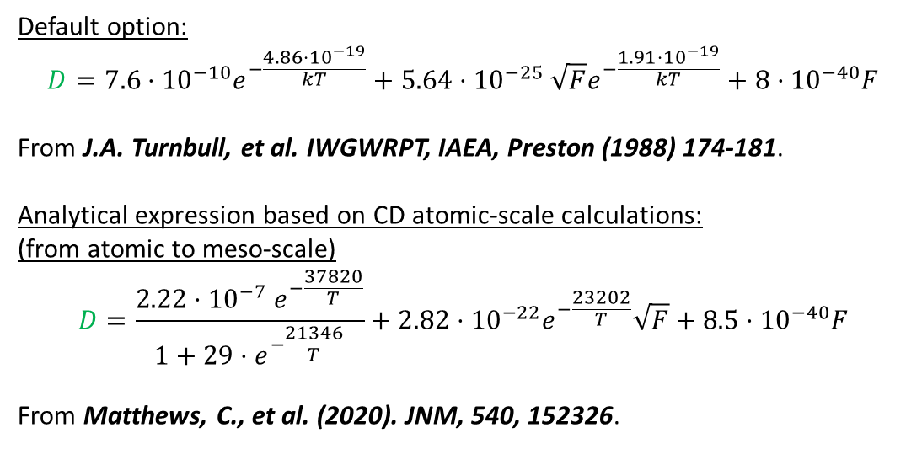

Developer side, Editing and (re)compiling
Intragranular gas diffusion
Fundamental parameters: diffusivity (single atoms), bubble nucleation, trapping, re-solution (w/ He solubility)
Physically-based single-size model derived from cluster dynamics (clusters with size n > 2 are counted as bubbles)
diffusivity (single atoms)
Default option:
$$D=7.6⋅{10}^{−10}e^{−\frac{4.86⋅{10}^{−19}}{kT}}+5.64⋅{10}^{−25} \sqrt{F}e^{−\frac{1.91⋅{10}^{−19}}{kT}}+8⋅{10}^{−40}F$$
From J.A. Turnbull, et al. IWGWRPT, IAEA, Preston (1988) 174-181.
Analytical expression based on CD atomic-scale calculations:
(from atomic to meso-scale)
$$D=\frac{2.22{⋅10}^{−7}e^{−\frac{37820}{T}}}{1+29⋅e^{−\frac{21346}{T}}}+2.82⋅{10}^{−22}e^{−\frac{23202}{T}}\sqrt{F}+8.5⋅{10}^{−40}F$$
From Matthews, C., et al. (2020). JNM, 540, 152326.
$$\left\{\begin{aligned}\frac{∂c}{∂t}=D∇^{2}c−gc+bm−λc+yF \\ \frac{∂m}{∂t}=+gc−bm−λm \\ \frac{dN_{ig}}{dt}=ν−bN_{ig}\end{aligned}\right.$$
Source code? Adding a new diffusivity formulation for Xe/Kr in UO₂

Slide 18
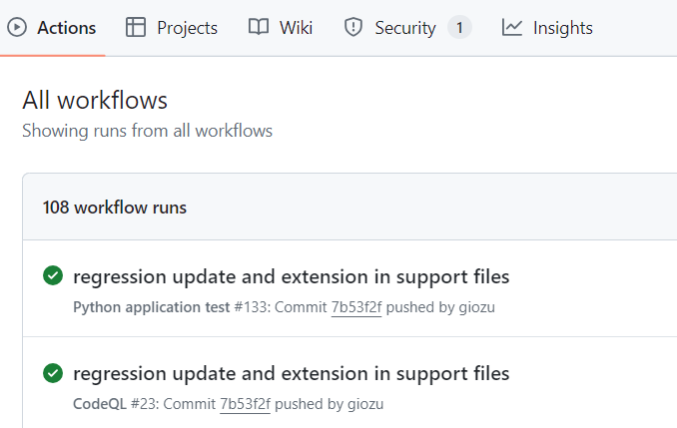


Developer side, Editing and (re)compiling
How to compile a modified source code?
Command line: issuing make command
Command line: issuing cmake command / also cmake in visual studio
Third-part programs (devc++, codeblocks, xcode, …)
Good practice:
Did you modify the code? Always RUN the regression tests!

Slide 19
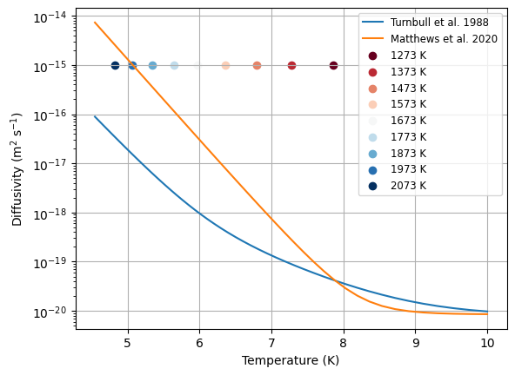
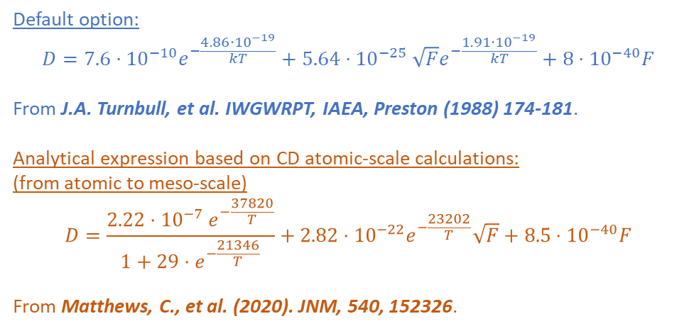
Developer side, Editing and (re)compiling
Default option:
$$D=7.6⋅{10}^{−10}e^{−\frac{4.86⋅{10}^{−19}}{kT}}+5.64⋅{10}^{−25} \sqrt{F}e^{−\frac{1.91⋅{10}^{−19}}{kT}}+8⋅{10}^{−40}F$$
From J.A. Turnbull, et al. IWGWRPT, IAEA, Preston (1988) 174-181.
Analytical expression based on CD atomic-scale calculations:
(from atomic to meso-scale)
$$D=\frac{2.22{⋅10}^{−7}e^{−\frac{37820}{T}}}{1+29⋅e^{−\frac{21346}{T}}}+2.82⋅{10}^{−22}e^{−\frac{23202}{T}}\sqrt{F}+8.5⋅{10}^{−40}F$$
From Matthews, C., et al. (2020). JNM, 540, 152326.

Slide 20
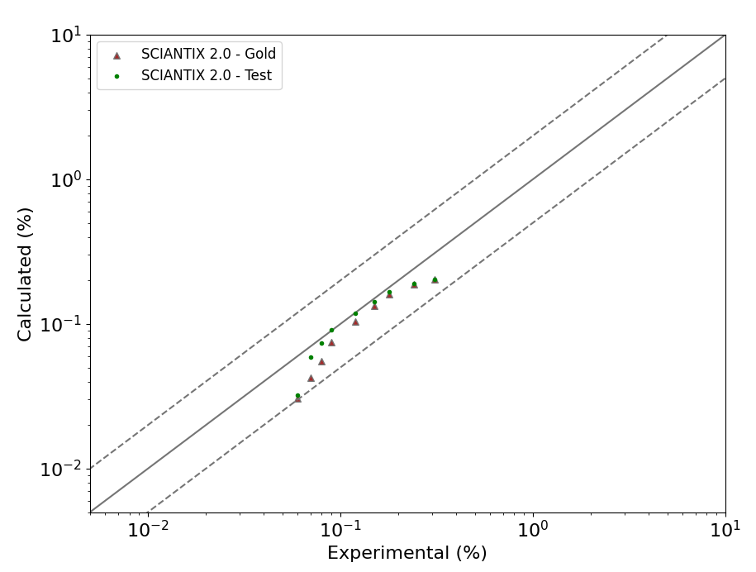
Developer side, Editing and (re)compiling

Slide 21
SCIANTIX: Advanced developments
Hands on the source code
Developer side: Editing and (re)compiling
Advanced modelling: Machine Learning with SCIANTIX
Survey
Giovanni Zullo
Lyon, France, 15.05.2024

Slide 22
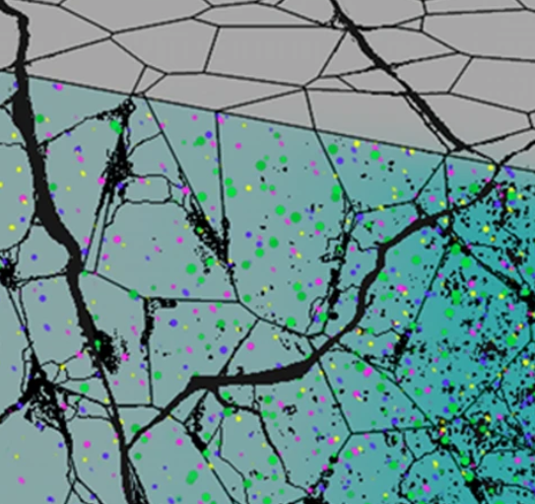
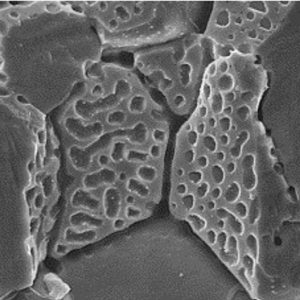
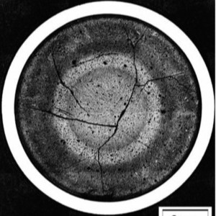
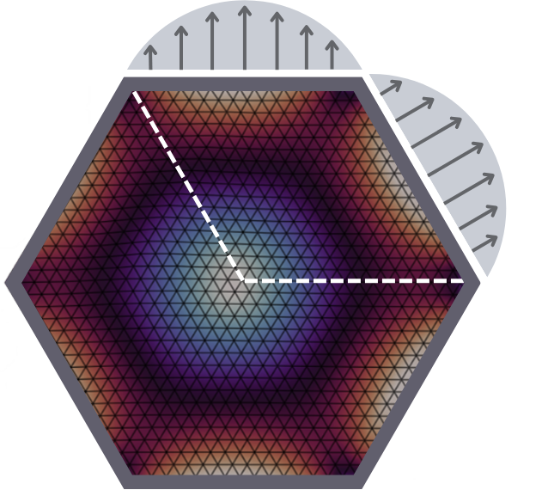
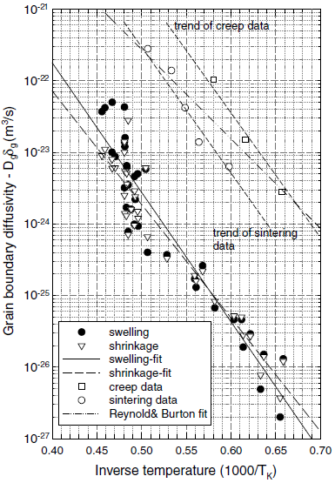
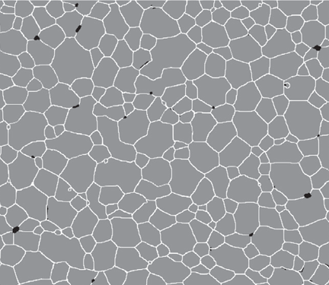
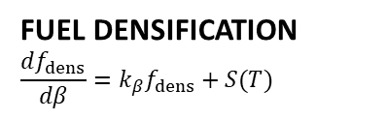
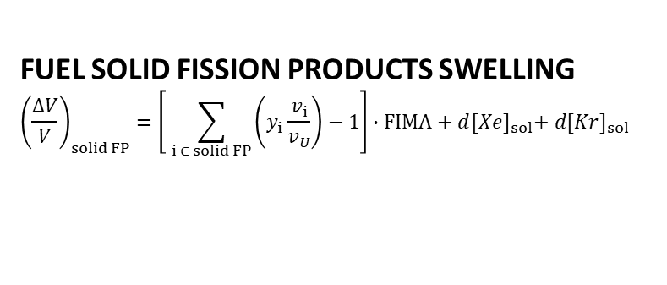
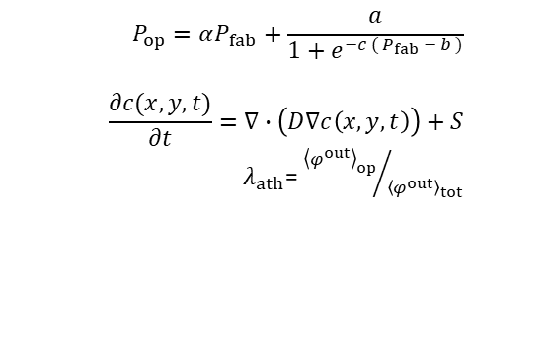

Advanced modelling, Machine Learning with SCIANTIX
FUEL SOLID FISSION PRODUCTS SWELLING
$${\left(\frac{∆V}{V}\right)}_{solid FP}=\left[ \sum_{i ∈ solid FP}{\left(y_{i}\frac{v_{i}}{v_{U}}\right)−1}\right]∙FIMA+d{[Xe]}_{sol}+ d{[Kr]}_{sol}$$
$$P_{op}=αP_{fab}+\frac{a}{1+e^{−c ({ P}_{fab} − b )}}$$
$$\frac{∂c(x,y,t)}{∂t}=∇∙\left(D∇c\left(x,y,t\right)\right)+S$$
$λ_{ath}$= ${{\left\langle φ^{out}\right\rangle }_{op}}/{{\left\langle φ^{out}\right\rangle }_{tot}}$
ATHERMAL FISSION GAS BEHAVIOUR
FUEL DENSIFICATION
$$\frac{df_{dens}}{dβ}={k_{β}f}_{dens}+S(T)$$
$$θ$$
GRAIN BOUNDARY VACANCY DIFFUSION

Slide 23
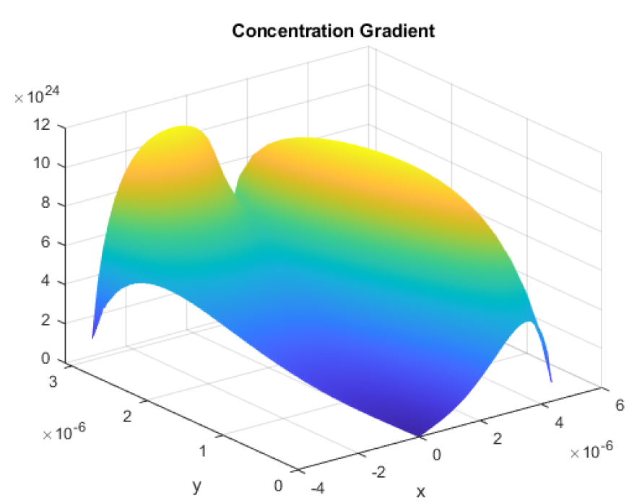

Advanced modelling, Machine Learning with SCIANTIX
HF solver
Grain-edge inclination angle, θ
$$\frac{∂c(x,y,t)}{∂t}=∇∙\left(D∇c\left(x,y,t\right)\right)+S$$
As-fabricated porosity, P_{fab}
Grain-edge length, l
Corrective factor, λ_{ath}
Burnup, β
Temperature, T
Gas generation rate, S
Gas initial concentration, C₀
input layer
single layer w/ 10 neurons
output layer

Slide 24
Validity range of the FNN features
Advanced modelling, Machine Learning with SCIANTIX
Quantity | Definition | Range
θ | Grain-edge inclination angle | 90 – 135 |  | °
P_{fab} | As-fabricated porosity | 2 – 9 |  | %
l | Grain-edge length | 3.67 – 11 |  | μm
β | Burnup | 0 – 50 |  | MWd kg⁻¹
T | Temperature | 300-1600 |  | K
S | Gas generation rate | Irradiation | Annealing | at m⁻³ s⁻¹
 |  | 10¹⁸ – 10²⁰ | 0
C₀ | Initial concentration | Irradiation | Annealing | at m⁻³
 |  | 0 | 10¹⁹ – 10²⁴

Slide 25
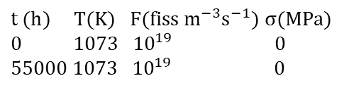
$t (h) T(K) F(fiss m^{−3}s^{−1}) σ(MPa)$
$0 1073 { 10}^{19} 0$
$55000 1073 {10}^{19} 0$
Advanced modelling, Machine Learning with SCIANTIX

Slide 26
In conclusion
SCIANTIX: Advanced developments
Hands on the source code
Developer side: Editing and (re)compiling
Advanced modelling: Machine Learning with SCIANTIX
Reference material: https://hdl.handle.net/10589/218541
Code repository: https://github.com/sciantix/sciantix-official
Contact
Giovanni Zullo: giovanni.zullo@polimi.it
Thanks for the attention!
Looking forward to your feedback

